Slide 1


Smart Contracts and Ethereum
Marco Galici, University of Cagliari
Cagliari, Italy

Slide 2







Course material developed in collaboration with University of Cagliari, University of Cyprus, University of Western Macedonia, Mines ParisTech, Technische Hochschule Ulm, Deloitte, WIP with support from Erasmus+

Slide 3
Content of the lecture
Ethereum blockchains
Ethereum platform
Smart contracts
Metamask
Remix

Slide 4

Ethereum
Ethereum is the second most known blockchain
Introduced in 2014 by Vitalik Buterin e Gavin Wood with the “Yellow Paper”
Innovation with respect to Bitcoin: Smart Contracts
Turing-complete program which run on blockchain
They adopt the so-called GAS to be executed

Slide 5
Ethereum: differences compared to Bitcoin
Bitcoin was born as a digital currency
Ethereum was born as a "distributed computer",
Bitcoin transaction inputs are unspent outputs of previous transactions (UTXO), in Ethereum each address has its own Ether balance
Bitcoin money transfers are from n input to m output, in Ethereum from 1 input to 1 output
In Ethereum transactions do not have "fee" for miners, but consume "gas" proportionally to the computational load; the gas however goes to the miner

Slide 6
Ethereum: differences compared to Bitcoin
Bitcoin Virtual Machine (VM) is limited, Ethereum’s is Turing-complete
The amount of Ether in circulation is not limited, but increases annually by no more than 18 million Ethers
The initial amount is approximately 72 million Ether
Currently, there are about 110 MEther
Ethereum blocks are validated every about 12", and therefore contain few transactions
Ethereum Pow (Ethash) is not only hash-power but requires 1-2 GByte of memory. For mining GPUs are used

Slide 7
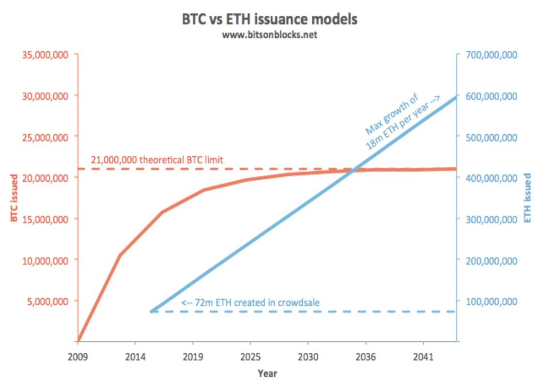
Bitcoin and Ether

Slide 8
Smart Contract in Ethereum
What is a Smart Contract (SC) (or contract)?
a small amount of code
a self-contained piece of code
a small amount of data
a set of public data
a small amount of Ether
a code that run on the Ethereum Virtual Machine (EVM)
The high-level language for SC is Solidity

Slide 9
What we cannot do with SC
Flight simulator on EVM (too many calculations!)
Blockchain videos (too much data)
A web server (there is no network access)
Digital Rights Management of blockchain information (BC is public)
All that requires a lot of calculation, a lot of memory or confidentiality

Slide 10
What we can do with SC
Alt-coin, token, notarization...
Crowdfunding, incentives for participants...
Voting systems, prediction markets, lotteries
Access control...
DAO: organisations managed on the blockchain
Management of fintech and supply chain transactions
Use your imagination...

Slide 11
Smart Contract - Ethereum
A smart contract is a program created by means of a transaction on blockchain:
It has an address which identify the contract
It can have public and private function callable from the external agents
Creating and modifying data inside a smart contract cost GAS (Ether): in this way it is protected from Denial of Service attacks
Public function of a smart contract are callable employing queries.

Slide 12
Input of a Smart Contract
All invocations of a SC function start from specific addresses
The public functions of a SC are listed in its ABI (Application Binary Interface) Json
A function call is called "sending a message" (msg)
To send a message, you need to know the ABI
The address from which a msg is known to the SC
In this way, the actors are identified:
Only the private key associated with the address can be used to send messages

Slide 13
Smart Contract - Ethereum
3 types of transactions:
Transfer of Ether
Creation of a SC
Calling a function on an SC (message)
The execution of a contract consumes "GAS", that is fractions of Ether, which go to the miners
In this way:
A contract always ends, even if for an error the corresponding program goes in infinite cycle
It is protected from DOS attacks, which would cost too much to the attacker

Slide 14
Example of an ABI
…
{
"constant":false, "inputs":[
{
"name":"_m",
"type":"uint256"
},
{
"name":"_h",
"type":"uint256"
}
],
"name":"addCert", "outputs":[
],
"payable":false,
"stateMutability":"nonpayable", "type":"function"
}
]
[
{
"constant":true, "inputs":[
{
"name":"_m",
"type":"uint256"
}
],
"name":"getHash", "outputs":[
{
"name":"",
"type":"uint256"
}
],
"payable":false, "stateMutability":"view", "type":"function"
},
…

Slide 15
A Smart Contract acts only on the BC
An SC, in creation or in response to an msg, can:
Making payments from Ether to certain addresses
Send msg to other SC
Write information on BC
Create other SC
Lifting Events, visible from the outside
An SC shall not:
Read information from the outside world by itself
Activating external actions
Activate without sending an msg (e.g., at a given time)

Slide 16
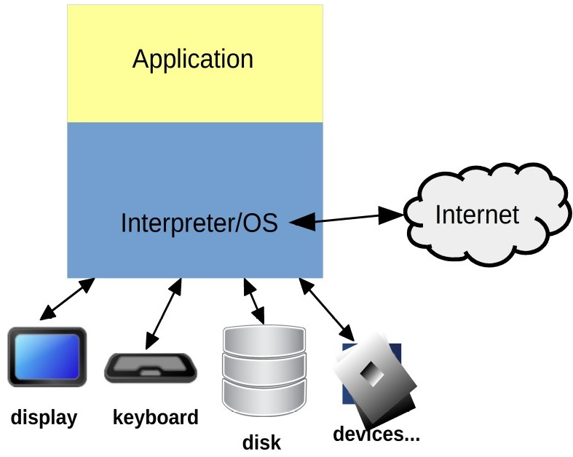
Architecture of traditional application
The application runs on the computer
It can access to internal and external devices
It can be activated by different triggers, such as OS trigger

Slide 17
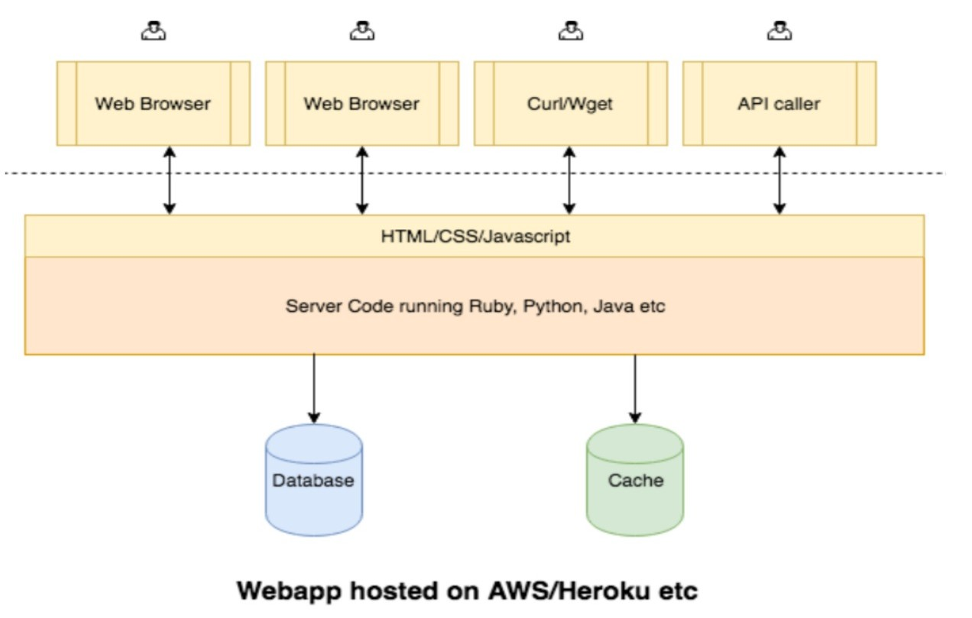
Web application architecture

Slide 18
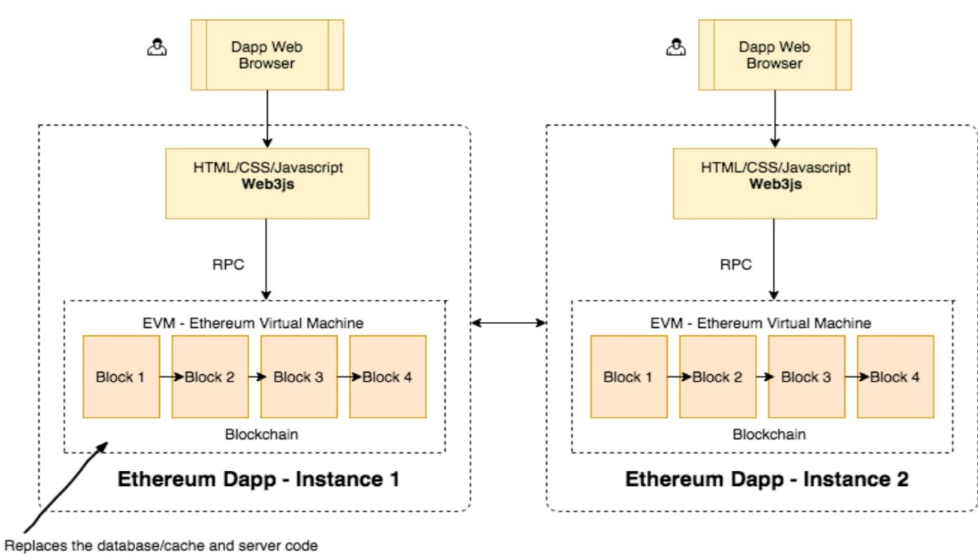
DApp Ethereum architecture

Slide 19
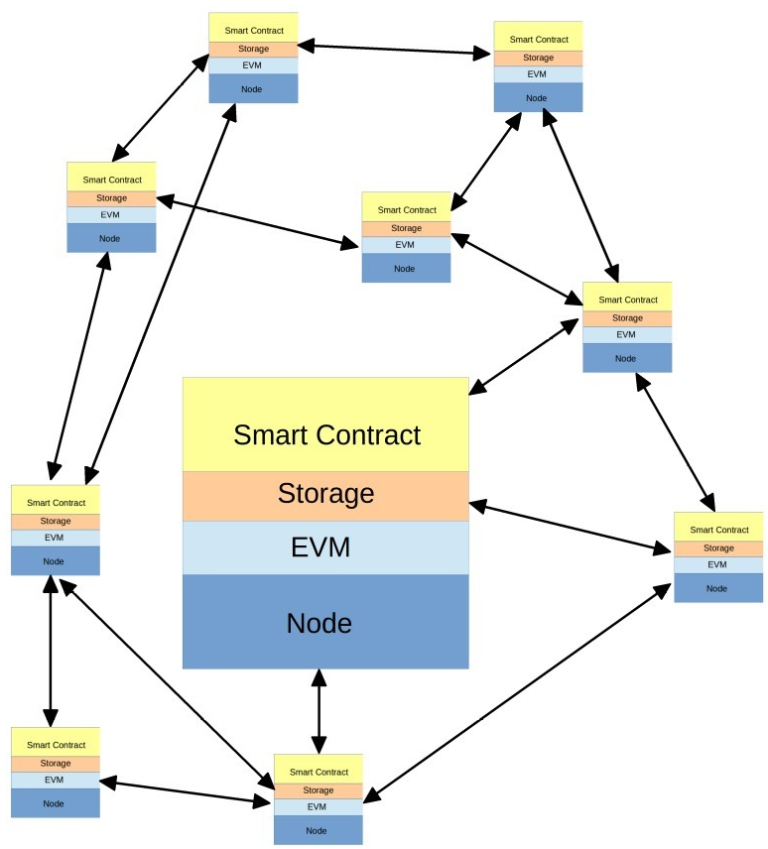
Smart Contract
The SC runs on each nodes of the network
Each smart contract and each msg has to produce the same output (no random numers)

Slide 20
Oracles
An oracle is an agent who finds information in the outside world and writes it in BC, to be used by SC
An oracle must be trusted
Examples: notification of stock prices, weather data, results for sports betting, etc.
An oracle is an external process, which activates a SC from a given address that identifies it, and writes data into the BC
Since the data of an oracle can have economic effects, the oracle must be trusted

Slide 21
Types of oracle
Software: a software process that detects info (usually from the Web) and writes it into BC
Hardware: an IoT device that detects an event and writes it in BC - e.g. opening a door
Outbound: a process that detects an event in BC and notifies it to an external device or system
Consensus-based: use of multiple independent oracles, with a combination of reported values to increase reliability

Slide 22
Ether (ETH)
Ether is the digital currency of Ethereum
Currently worth about 100 US $
Has several sub-multiples:
Finney: 10⁻³ ETH - 1.000.000.000.000.000 Wei
Szabo: 10⁻⁶ ETH - 1.000.000.000.000 Wei
Shannon: 10⁻⁹ ETH - 1.000.000.000 Wei
Babbage: 10⁻¹² ETH - 1.000.000 Wei
Ada: 10⁻¹⁵ ETH - 1.000 Wei
Wei: 10⁻¹⁸ ETH - 1 Wei
Transactions and calculation of ”GAS" are in Wei

Slide 23
Ethereum addresses
Ethereum, like Bitcoin, uses private/public key encryption to protect addresses
It uses a 256-bit private key:
From this generates the associated public key, using the ECDSA algorithm with secp256k1 curve
Then generate the address using the last 20 bytes of the SHA3-256 public key hash
Much simpler and more linear than in Bitcoin!
Ethereum addresses are given as hexadecimal representation, that is, as 40 digits, from "0" to "f".
Examples:
0xcd2a3d9f938e13cd947ec05abc7fe734df8dd826
0x21476eac473d94e8255ba4825c59f2e3776360e9

Slide 24
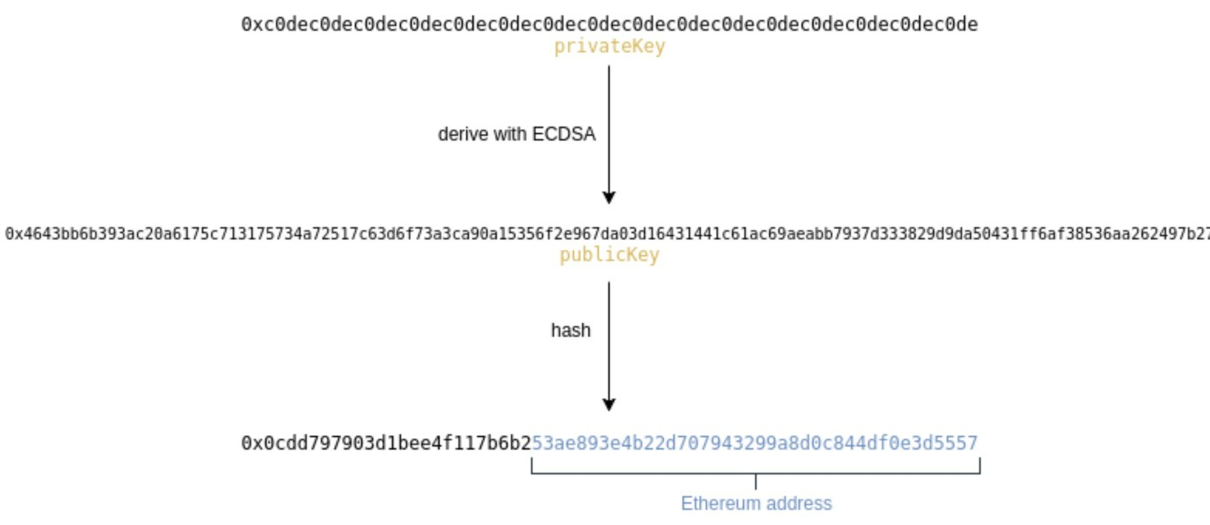
Ethereum addresses

Slide 25
Checksum in Ethereum
Ethereum, unlike Bitcoin, has no intrinsic mechanisms to control the validity of an address
However, a method, introduced by Buterin, is used to add a check to the address:
calculate the address SHA3 hash
the hash is considered as a binary number
the alphabetic characters of the address (a-f) are written as uppercase if the hash bit in the corresponding position is 1, otherwise as lowercase:
0xcd2a3d9f938e13cd947ec05abc7fe734df8dd826
0xCd2a3d9f938e13Cd947eC05ABC7fe734df8DDD826

Slide 26
Address and accounts
Ethereum blockchain keeps Ethers inside wallet accounts
An account is associated with an address and maintains the following data:
nonce: number of outgoing transactions
balance: amount of Ether in the account
storageRoot: hash associated with account storage
codeHash:
if it is a normal account, it is worth zero
if it is a contract, it contains the hash of the bytecode

Slide 27
Ethereum account
Ethereum has two types of accounts:
Normal account
Contract
Normal accounts:
contain Ethers
are accessible by the owner of the private key corresponding to the address
are the subject of transactions to transfer Ether
Contracts:
contain Ethers
are programs that can be activated by messages sent by a user address or by another contract

Slide 28
Ethereum transactions
A transaction can transfer Ether from one account to another (there are no multiple inputs/outputs)
Data of a transaction:
nonce: progressive number of the transaction leaving the account
Gas: price of "gas" in Wei
gasLimit: maximum amount of gas to process the transaction
to: address of the "target" account
value: amount of Ether to be transferred
date: may be an arbitrary value, the code of a contract to be created, the function call of the existing contract to the address "to"

Slide 29
Ethereum GAS
Each Ethereum transaction consumes "gasoline" (gas)
Gas is a quantity of Wei, which goes to the miner that validates the block with the transaction
Each computational step costs a given amount of gas, established by tables
The price of the gas is determined by the sender of the transaction. It varies depending on the state of the network, and must be accepted by miners (if too low, the transaction may not be accepted)
gasLimit sets a usable gas limit. If exceeded, the transaction is cancelled (but the gas goes to the miner)

Slide 30
Ethereum GAS
gasLimit cannot exceed a given amount, to avoid endless calculations and DoS attacks
In 2020, it was about 10 million gas per block (the maximum limit is calculated on all transactions of a block)
A transaction always costs at least 21.000 GAS (in 2020 it was about 0.06 US$)
Registering a contract has a base cost of 53.000 GAS (21.000 transaction + 32.000 creation)
Site with real-time gas data: https://ethgasstation.info/

Slide 31
Ethereum GAS
Mnemonic | Gas Used | Notes
STOP | 0 | Halts execution.
ADD | 3 | Addition operation
MUL | 5 | Multiplication operation.
LT | 3 | Less-than comparison.
ADDRESS | 2 | Get address of currently executing account.
BALANCE | 400 | Get balance of the given account.
CALLER | 2 | Get caller address.
EXTCODESIZE | 700 | Get size of an account’s code.
BLOCKHASH | 20 | Get the hash of one of the 256 most recent complete blocks.
MLOAD | 3 | Load word from memory.
MSTORE | 3 | Save word to memory
MSTORE8 | 3 | Save byte to memory.
SLOAD | 200 | Load word from storage
JUMP | 8 | Alter the program counter
JUMPI | 10 | Conditionally alter the program counter.
Gas cost of some instructions

Slide 32
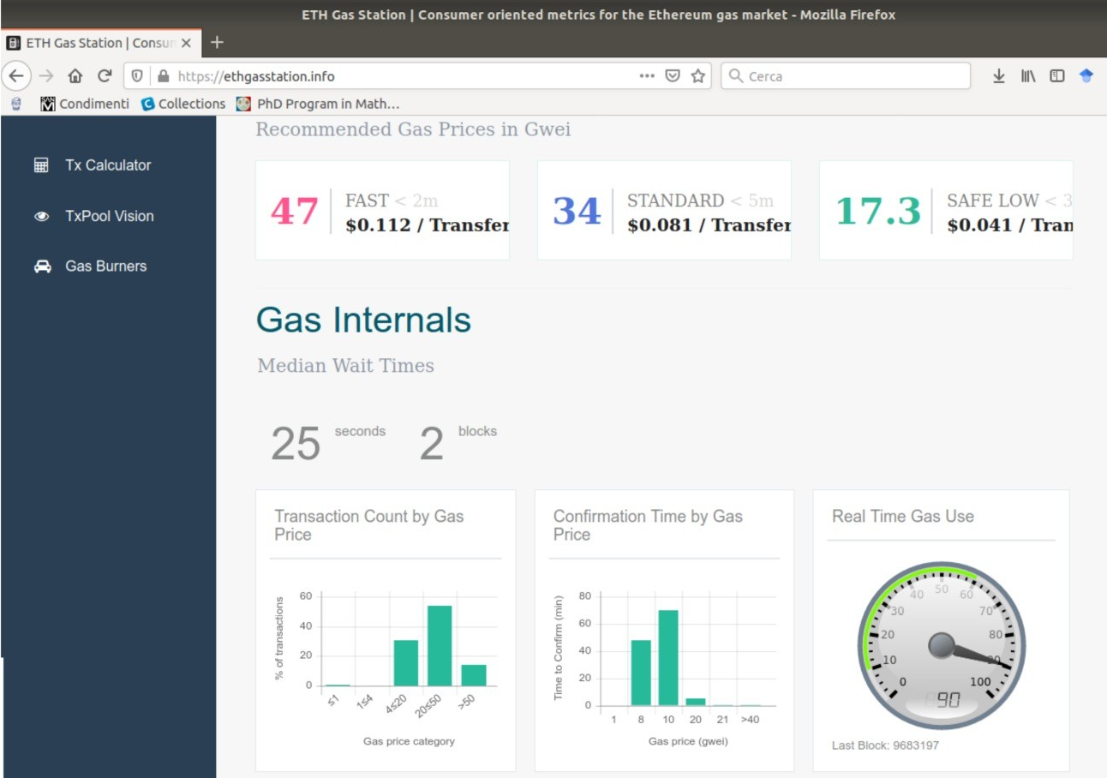
ethgasstation.info

Slide 33
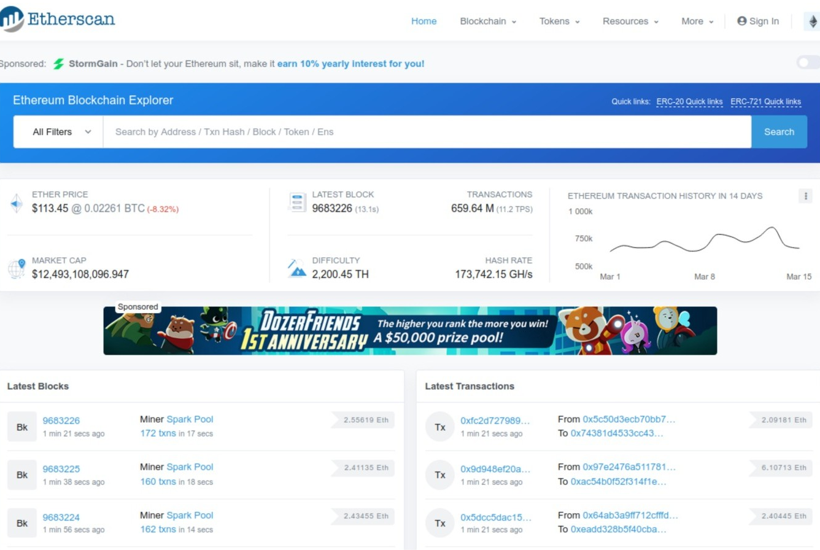
etherscan.io
Tools for observing Ethereum:
etherscan.io:
provides network and transaction statistics
allows you to explore:
blocks and blocks
Transactions
Address
Contracts
allows you to explore the status of tokens that have been issued on Ethereum
also allows you to explore testnets
Alternative site to explore Ethereum: etherchain.org

Slide 34
Ethereum development environments
Remix (https://remix.ethereum.org) as IDE (interactive development environment)
Supported by the Ethereum Foundation
Easy to use
Run on a browser (optimised for Chrome)
Metamask (https://metamask.io) as a wallet to create and maintain private keys, and interact with the blockchain
Integrated with Remix
Etherscan.io to test and explore results

Slide 35
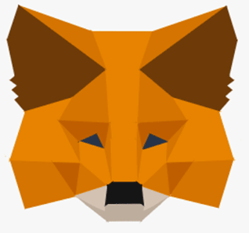
Metamask
Metamask runs on Web browser or on mobile terminal
It is possible to download it as a plugin or application
It is able to manage Ethereum wallet, with private key stored on the client
It can interact with Ethereum main net, but also with testnet such as Ropstein, Kovan, Rinkeby and local server
It is integrated within Remix

Slide 36
How to use Metamask
From the browser (better Chrome), install the plugin "Metamask" enabling it to access the system
Enter a password of at least 8 characters
If you are going to use the wallet to store real ETH, the password must be very robust!
Accept copyright and conditions.
Metamask starts creating the first account
It generates 12 English words (Secret Backup Phrase) from which it will generate the private keys associated with the account
Save the words on a sheet of paper or whatever you want, but in any case not on a PC/smartphone connected to the Internet
If you lose your password or your PC loses everything, you can restore your Metamask account with the 12 words
Metamask generates private key and its address and then it asks you if you want to deposit ETH or connect to Coinbase or to buy them by exchange

Slide 37
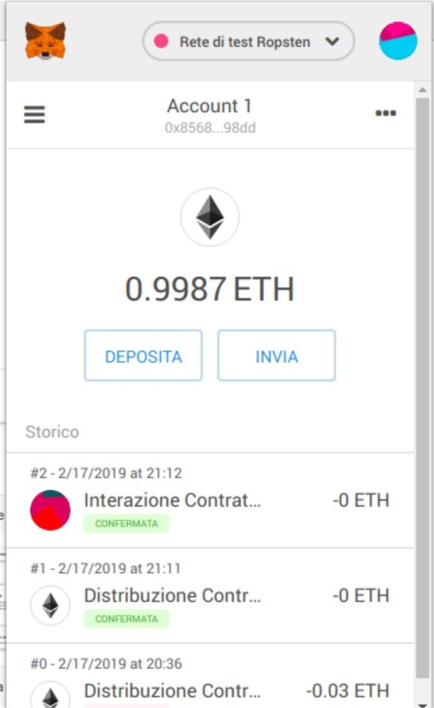
How to use Metamask
On the top right part of the window you can set the Ethereum net:
Mainnet
Testnet Ropsten
Testnet Kovan
Testnet Rinkeby
Testnet Goerli
Localhost on port 8545
Dedicated RPC
It shows the current account data:
ETH deposit
Transaction history

Slide 38
Metamask tutorial
https://docs.metamask.io/guide/
https://medium.com/portalnetworkofficial/how-to- use-metamask-extension-6e9b7f95176f
https://www.slideshare.net/Kenneth_hu/ 20180711-metamask

Slide 39

Remix
IDE of Ethereum foundation, specifically developed for Solidity
It runs on web browser (optimised for Chrome)
It is integrated with Metamask

Slide 40
How to use Remix
Typically requires Internet connection
Can also download a local version
Save the source of the contracts developed in the browser folders
Can also connect to Github repositories
Can connect to local file system
Can send transactions to:
Main net and test net Ethereum (via Metamask): Injected Web3
A local Ethereum VM managed by Remix: Javascript VM (correct option at start of development)
An Ethereum node, local or accessible via Web: Web3 Provider

Slide 41
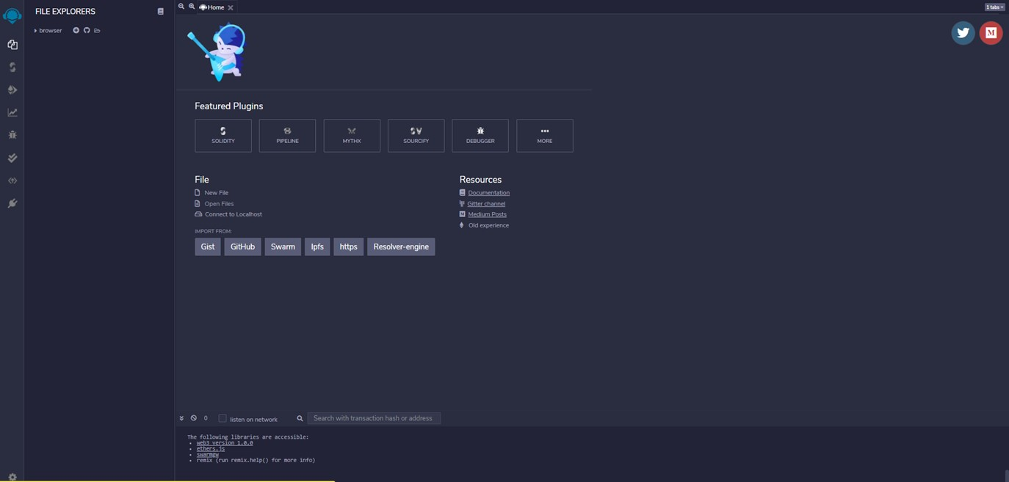
How to use Remix

Slide 42
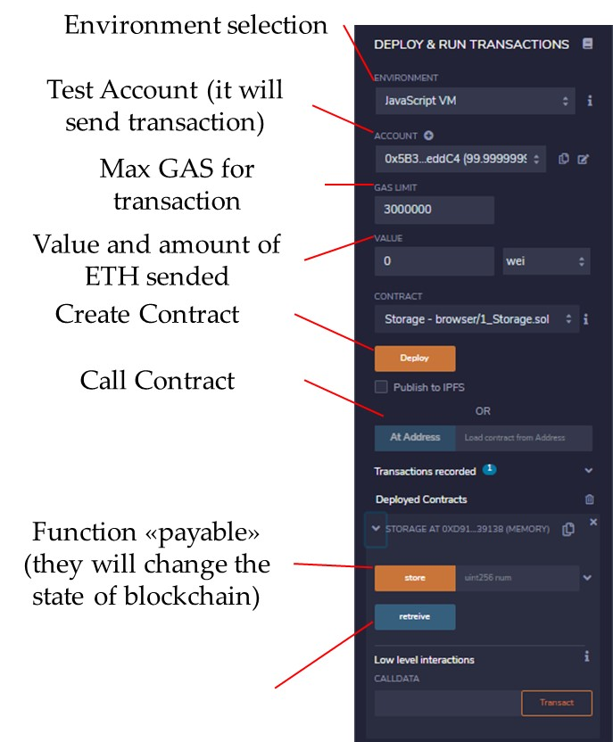
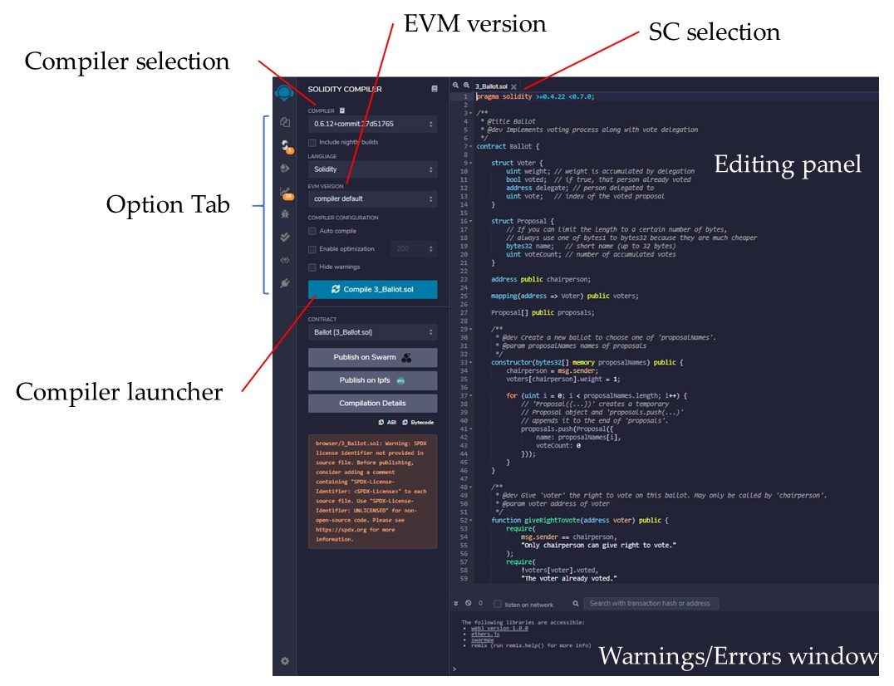
How to use Remix

Slide 43
Remix - warnings
Beware of the source of yours programs!
At first, they are stored in the browser cache, so it should be backed up often
To import a file from the list on the right you must first enter the name "browser/"
The declared compiler version shall be compatible with that of the selected compiler
Compiler version and presence or not of the optimization option are important for the eventual publication on etherscan.io of the SC source
The console works when sending transactions, not when compiling
To get the details of a transaction, click with the mouse on the corresponding line in the console

Slide 44
Thank you for your attention!
www.smartgridsmaster.eu

